Slide 1
Parsing and Parsing Table
Course Code: CSC3220
Course Title: Compiler Design
Dept. of Computer Science
Faculty of Science and Technology
Lecture No: | 10 | Week No: | 10 | Semester: | Fall 2023-2024
Lecturer: | Shahnaj Parvin; sparvin@aiub.edu

Slide 2
Lecture Outline
Quiz
Parsing
Parsing Technique(LL1 Grammar)
Parsing Table Construction Technique
Examples
Exercises

Slide 3
Objective and Outcome
Objective:
To provide an overview of parsing and parsing types.
To give an overview of predictive parser
To demonstrate the predictive parsing table construction for predictive / LL(1) parser from a given CFG
Outcome:
After this lecture the students will be able to understand basics of predictive and LL (1) parser.
The students will be capable of constructing a predictive parsing table from given CFG

Slide 4
Quiz
Quiz

Slide 5
Parsing
The process of determining if a string of terminals (tokens) can be generated by a grammar.
Time complexity:
For any CFG there is a parser that takes at most O(n³) time to parse a string of n terminals.
Linear algorithms suffice to parse essentially all languages that arise in practice.
Two kinds of methods:
Top-down: constructs a parse tree from root to leaves
Bottom-up: constructs a parse tree from leaves to root

Slide 6
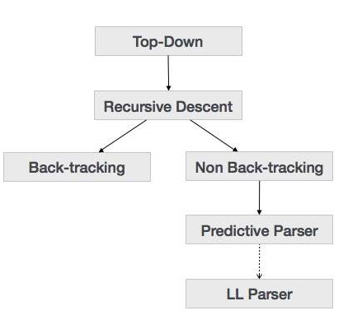
Types of Parsing

Slide 7
Parsing Table Overview
A Parsing table collects information from FIRST and FOLLOW set.
A Parsing table provides a direction/predictive guideline for generating a parse tree from a grammar.
A Parsing table provide information to create moves made by a predictive parser on a specific input.

Slide 8
LL(k) LL(1) Parser Design Prerequisite
Make the grammar suitable for top-down parser. By performing the elimination of left recursion. And by performing left factoring.
Find the FIRST and FOLLOW of the variables.
Create Parsing table based on the information from FIRST and FOLLOW sets.

Slide 9
Predictive (LL1) Parsing Table Construction Rule
Collect information from FIRST and FOLLOW sets into a predictive parsing Table M[A,a]
M[A,a] is a 2D array where,
A is nonterminal
“a” is a terminal or the symbol $, the input endmarker
The Production A -> a is chosen if the next input symbol a is in First (A).
If a = ε, we should again choose A-> a, if the current input symbol is in FOLLOW (A) or if the $ on the input has been reached and $ is in the FOLLOW(A)

Slide 10
Predictive (LL1) Parsing Table Construction Rule
From a Grammar Find out First and Follow
Take a production; Row should be left hand side and column should be first of right and side
If we see epsilon in first of right hand side, place the production in follow also
If first of right hand side terminal, directly place in table
If the first of right hand side is epsilon, directly place in follow of left hand side

Slide 11
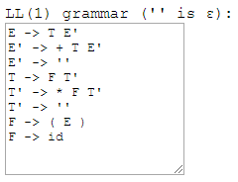
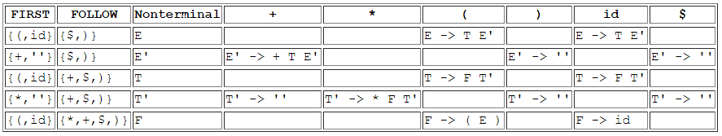
Parsing Table Construction (Example)

Slide 12
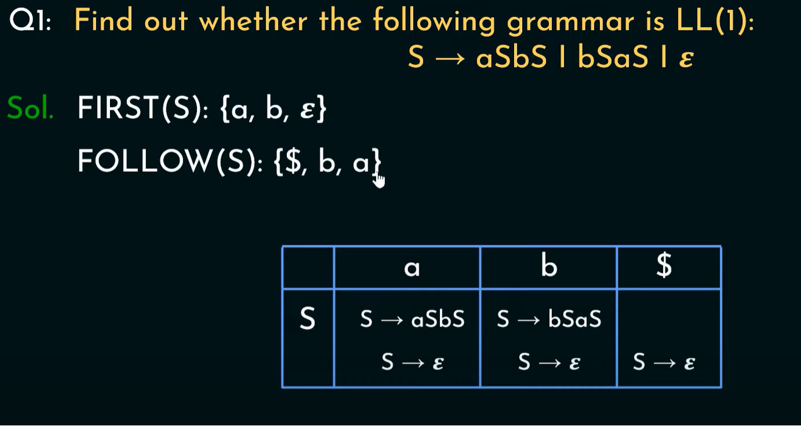

Slide 13
Exercises:
Find out whether the following grammar is LL(1):
S → AaAb | BbBa
A → ε
B → ε

Slide 14
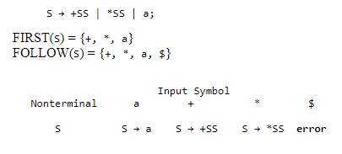
Predictive parsing table for the grammar (Example 1)

Slide 15
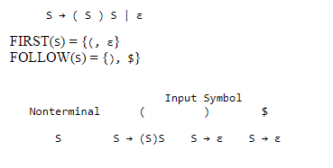
Predictive parsing table for the grammar (Example 2)

Slide 16
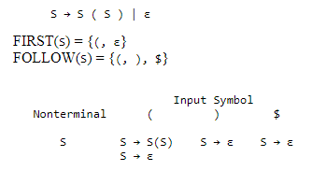
Predictive parsing table for the grammar (Example 3)

Slide 17
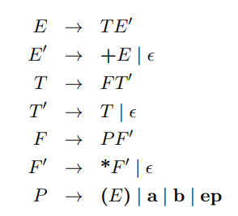
Parsing Table Construction (Problem)
Consider the following LL(1) grammar, which has the set of terminals T = fa; b; ep; +; *; (; )g. This grammar generates regular expressions over fa, bg, with + meaning the RegExp OR operator, and ep meaning the ε symbol. (Yes, this is a context free grammar for generating regular expressions!)

Slide 18
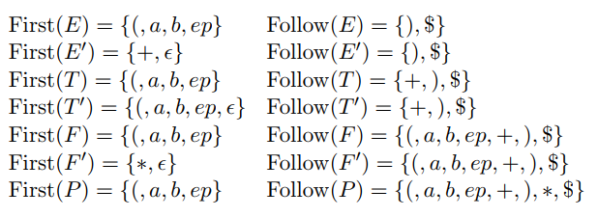
Parsing Table Construction (Solution)
FIRST and FOLLOW sets

Slide 19
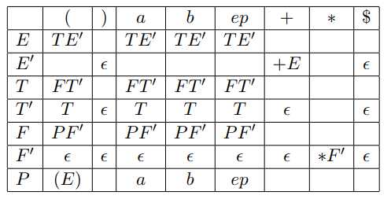
Parsing Table Construction (Solution)
LL (1) Parsing Table

Slide 20
Lecture References
Carnegie Mellon University Material
https://www.cs.cmu.edu/~fp/courses/15411-f09/lectures/08-predictive.pdf
Columbia University Material
http://www1.cs.columbia.edu/~aho/cs4115/lectures/13-02-20.htm
Online Material
https://www.ques10.com/p/8960/construct-predictive-passing-table-for-following-2/
Online Tutorial
https://www.tutorialspoint.com/compiler_design/compiler_design_top_down_parser.htm

Slide 21
References/ Books
1. Compilers-Principles, techniques and tools (2nd Edition) V. Aho, Sethi and D. Ullman
2. Principles of Compiler Design (2nd Revised Edition 2009) A. A. Puntambekar
3. Basics of Compiler Design Torben Mogensen

